Slide 1

Notebookbar Structure
Andreas Kainz

Slide 2
Location of the Notebookbar files
    loleaflet/src/control/Control.NotebookbarWriter.js
    loleaflet/src/control/Control.NotebookbarCalc.js
    loleaflet/src/control/Control.NotebookbarImpress.js
    loleaflet/src/control/Control.NotebookbarDraw.js
    loleaflet/src/control/Control.Notebookbar.js
    loleaflet/src/control/Control.NotebookbarBuilder.js

Slide 3

loolwsd.xml
<user_interface>
<mode type="string" desc="Controls the user interface style
(classic|notebookbar)" default="classic">notebookbar</mode>
</user_interface>

Slide 4
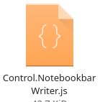
Control.NotebookbarWriter.js
getTabs: function() { // generate the tabs
return [
{
'text': _('~File'), // File tab
'id': '-1',
'name': 'File',
},
{
'text': _('~Home'), // Home tab
'id': this.HOME_TAB_ID,
'name': 'Home',
'context': 'default|Text|DrawText' // select tab by context
},

Slide 5

Control.NotebookbarWriter.js
{
'type': 'bigtoolitem',
’text': _UNO('.uno:Paste'),
'command': '.uno:Paste'
},
{
'type': 'container',
'children': [
{
'type': 'toolbox',
'children': [
{
'type': 'toolitem',
'text': _UNO('.uno:Cut'),
‘command': '.uno:Cut'
},
{
'type': 'toolitem',
'text': _UNO('.uno:FormatPaintbrush'),
'command': '.uno:FormatPaintbrush'
}
]
},
{
'type': 'toolbox',
'children': [
{
'type': 'toolitem',
'text': _UNO('.uno:Copy'),
'command': '.uno:Copy'
},
{
'type': 'toolitem',
'text': _UNO('.uno:ResetAttributes'),
'command': '.uno:ResetAttributes'
}
]
}
],
'vertical': 'true'
},

Slide 6
Control.NotebookbarWriter.js
{
'type': 'bigtoolitem',
’text': _UNO('.uno:Paste'),
'command': '.uno:Paste'
},

Slide 7
Control.NotebookbarWriter.js
{type: 'bigtoolitem', uno: 'Paste'},
{
'type': 'container',
'children': [
{
'type': 'toolbox',
'children': [
{
'type': 'toolitem',
'text': _UNO('.uno:Cut'),
‘command': '.uno:Cut'
},
{ ... },
]
},

Slide 8
Control.NotebookbarWriter.js
{type: 'button', uno: 'Paste'},
{type: 'container',
items: [
{uno: 'Cut'},
{uno: 'FormatPaintbrush'},
]
items: [
{uno: 'Copy'},
{uno: 'ResetAttributes'},
]
},

Slide 9
Control.NotebookbarWriter.js
{
'type': 'bigtoolitem',
’text': _UNO('.uno:Paste'),
'command': '.uno:Paste'
},
{
'type': 'container',
'children': [
{
'type': 'toolbox',
'children': [
{
'type': 'toolitem',
'text': _UNO('.uno:Cut'),
‘command': '.uno:Cut'
},
{
'type': 'toolitem',
'text': _UNO('.uno:FormatPaintbrush'),
'command': '.uno:FormatPaintbrush'
}
]
},
{
'type': 'toolbox',
'children': [
{
'type': 'toolitem',
'text': _UNO('.uno:Copy'),
'command': '.uno:Copy'
},
{
'type': 'toolitem',
'text': _UNO('.uno:ResetAttributes'),
'command': '.uno:ResetAttributes'
}
]
}
],
'vertical': 'true'
},

Slide 10

Control.NotebookbarWriter.js
{type: 'button', uno: 'Paste'},
{type: 'container',
items: [
{uno: 'Cut'},
{uno: 'FormatPaintbrush'},
]
items: [
{uno: 'Copy'},
{uno: 'ResetAttributes'},
]
},
Notebookbar Compact

Slide 11
Control.NotebookbarWriter.js
{type: 'button', uno: 'Paste'},
{type: 'container',
items: [
{uno: 'Cut'},
{uno: 'FormatPaintbrush'},
]
items: [
{uno: 'Copy'},
{uno: 'ResetAttributes'},
]
},
Notebookbar Compact

Slide 12
loleaflet/css/Notebookbar.css
    665 lines of style definitions
NotebookbarCompact.css
    = Notebookbar.css
    + arrangement definitions
    + hidden commands (less space needed)

Slide 13

Thanks
Issues: #1257
https://github.com/CollaboraOnline/online/issues/1257
Andreas Kainz

Slide 14
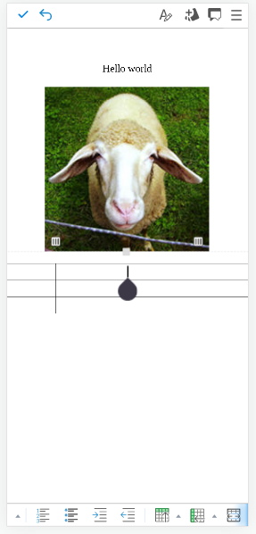
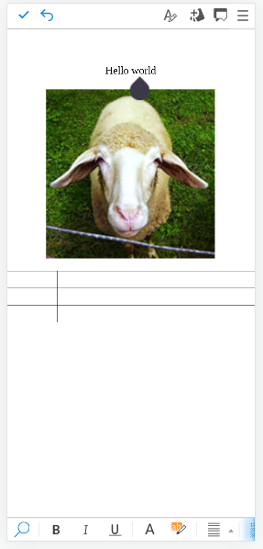
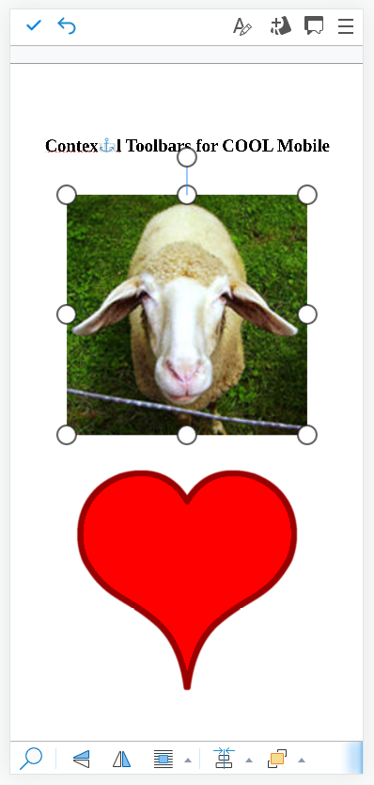
Context [‘Table’]
Context [‘Text’]
Context [‘Graphic’]

Slide 15
Control.MobileBottomBar.js
{type: 'button', uno: '.uno:Bold', context: ['default|Text']},
{type: 'button', uno: '.uno:Italic', context: ['default|Text']},
{type: 'button', uno: '.uno:Underline', context: ['default|Text']},
{type: 'break', context: ['Text']},
{type: 'menu', uno: '.uno:TextAlign', context: ['default|Text'],
items: [
{uno: '.uno:LeftPara'},
{uno: '.uno:CenterPara'},
{uno: '.uno:RightPara'},
{uno: '.uno:JustifyPara'},
]},

